Slide 1
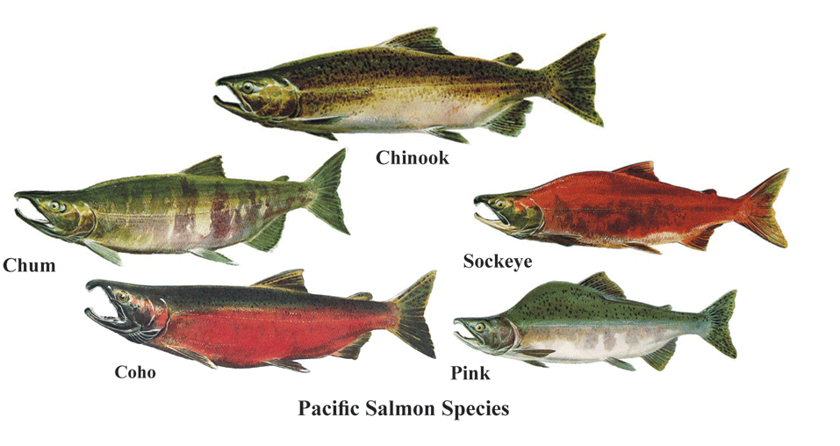
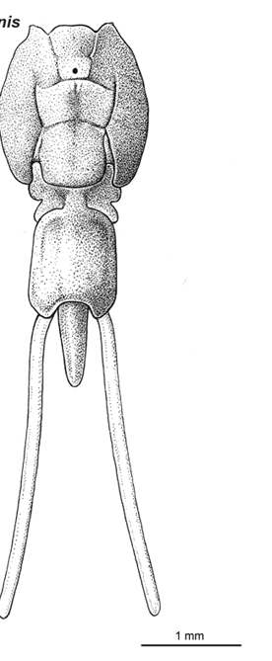
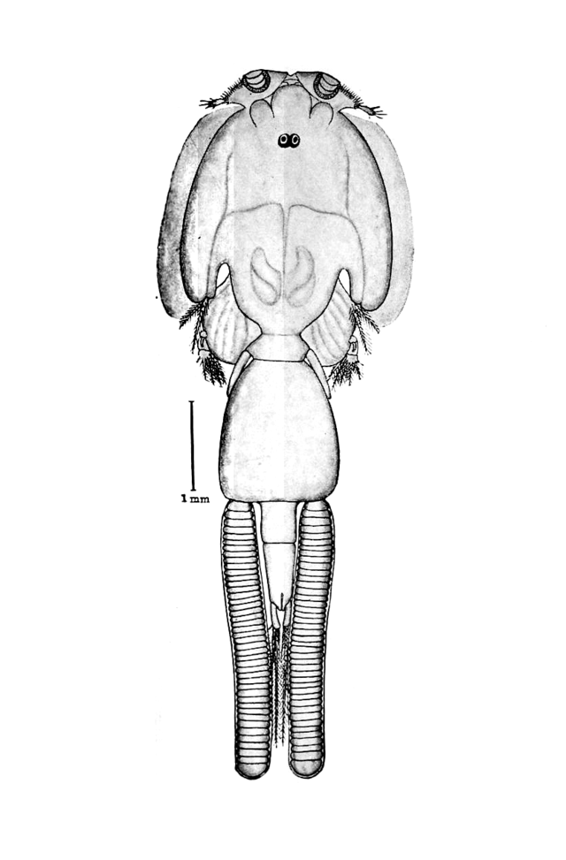
EEB499 Research Project
Project Background & Initial Results

Slide 2
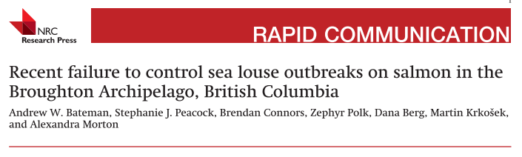
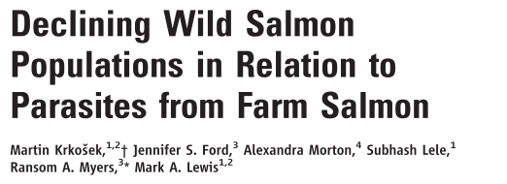
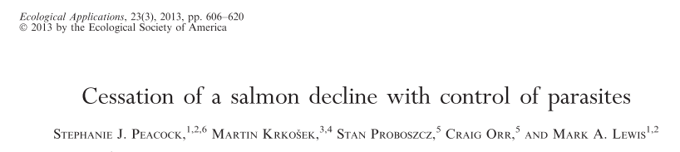
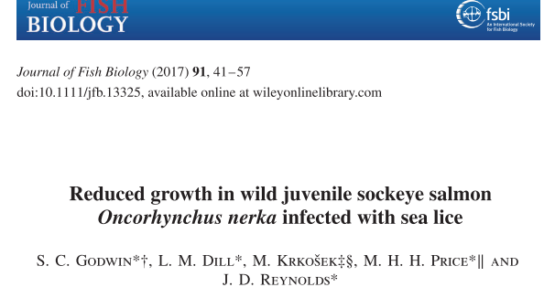
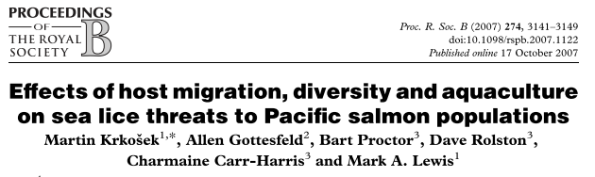
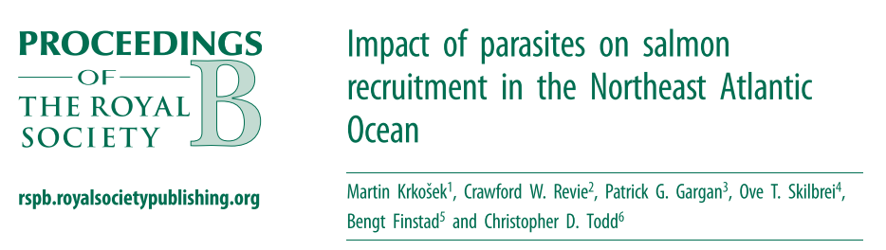
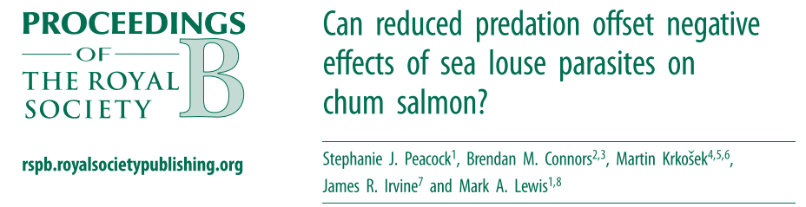
Introduction Study System Importance of Lice Parasitism Methods Initial Results Next Steps

Slide 3

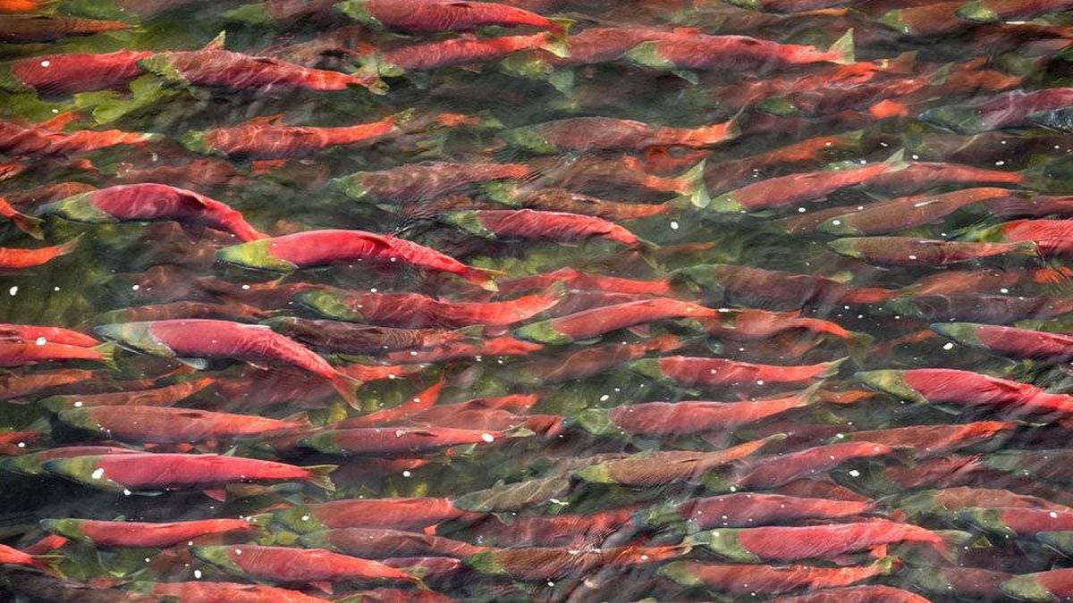
Introduction Study System Importance of Lice Parasitism Methods Initial Results Next Steps
Juvenile Salmon Marine Survival Program
feeding biology
growth
condition factor
parasite and pathogen load
Notes:
Since 2015, the Hakai institute has been running a program called the Juvenile Salmon Marine Survival Program. And the goal of this program is to understand what happens to juvenile salmon in the first few months of their lives when they leave their freshwater streams and head out to the ocean. When juvenile salmon leave their natal rivers and spend their first few months at sea, there are a whole host of threats that they encounter. The reason this is of interest, is this time period and this region could be a chokepoint in their survival – if the fish don’t have a lot to eat in this intermediary region, then they need sufficient energy reserves to make it through this region and out to the north on the other side, but they encounter a whole bunch of other factors that limit their survival on the way. And so when these fish are sampled, the goal of the program is to anlayze a whole bunch of different factors that could be affecting survival, including parasite and pathogen load, which is the subset of this that I have the opportunity to work on right now. This work specifically targets the Fraser River Sockeye which is BC’s most important fisheries stock

Slide 4
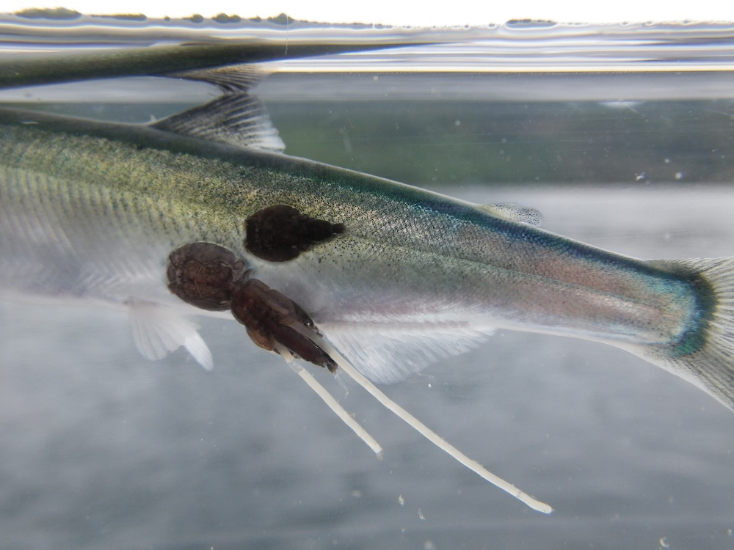
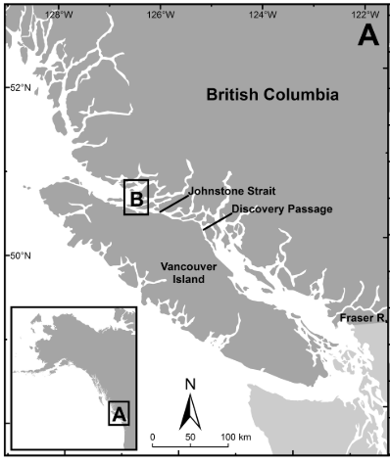
Introduction Study System Importance of Lice Parasitism Methods Initial Results Next Steps
(Godwin et al. 2015)
Notes:
Sea lice are marine ecotoparasites that occur on salmon and other pacific wild fish naturally, it’s been noted for decades that this is something that happens. However, there has been evidence emerging for some time now, in large part from this lab, that the dynamics of sea lice and salmon are changing. This is potentially in large part due to fish farming of atlantic salmon along the coast. Usually, what happens is juvenile salmon emerge from their natal freshwater rivers, and enter the marine environment at a young age. This happens in the early spring, and the juveniles aren’t exposed to the salmon lice until the end of the summer once they’ve migrated up the coast of the mainland, and through Johnstone Strait and out into Queen Charlotte sound. Later on in this journey, the juveniles will become sympatric with the in-migrating adult salmon, some of whom are infected with salmon lice, at which point vertical transmission between the older salmon and the juveniles will occur. However, with the addition of fish farms along the coast, this whole dynamic is changed. These fish farms are usually Atlantic salmon, and can hold really high numbers of individuals. These farms can act as refugia for lice, in the sense that once the adult salmon have moved back down the coast, they pass the lice to the captive Atlantic salmon, who then harbour the lice (potentially in really high numbers). This is where the problem lies, when the juvenile salmon come out of the Fraser River, they are exposed to sea lice when they are 3 months younger and sometimes 10-100 times smaller than they would be by the time they become sympatric with the adult salmon again.

Slide 5
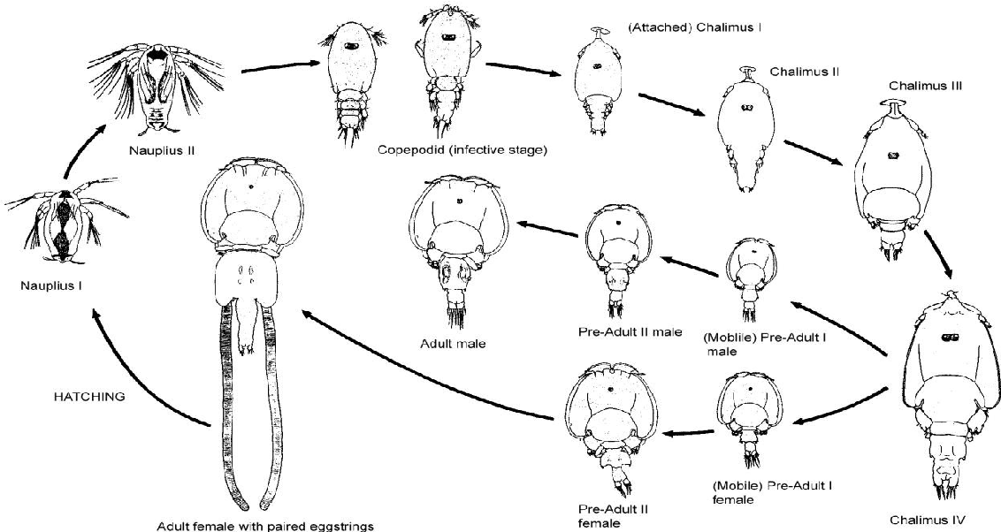
Introduction Study System Importance of Lice Parasitism Methods Initial Results Next Steps
L. salmonis
C. clemensi
Notes:
So these are the species that I have in my dataset, we can see here sockeye, chum and pink salmon. And the two species of sea louse – Lepeopthierus Salmonis and Caligus Clemensi. L. Salmonis is a salmon specialist, C. clemensi is a generalist that infects a number of different marine fish species. They have a number of life stages, starting with planktonic naupliar stages, free-swimming infectious copepodid infectious stage, attached chalimus stages, and motile adult phasesBoth of them cannot survive in freshwater environments, which is why juvenile salmon are not at risk until they leave their natal streams. Now all of these salmon are at risk of infection from both of these ectoparasites, and infection can cause a variety of outcomes

Slide 6
Introduction Study System Importance of Lice Parasitism Methods Initial Results Next Steps
Most Important Fishery in British Columbia
In decline for many years
26 million dollar Federal inquiry into their decline
Pinks are another of Canada’s biggest salmon Fisheries
Chum & pink school together
Both leave freshwater environments at small sizes
Notes:
And there’s a reason why these three species of salmon are of interest specifically. All three of them migrate through the same environment, and pink and sockeye salmon are incredibly important fisheries stocks. Sockeye have been in decline for some time, which is of huge concern to the government, and so there is significant interest in understanding what effect sea lice in particular have on this species. Pink and chum are also heavily parasitized by sea lice, but these two are specifically at risk, mostly due to the fact that they leave their freshwater environments almost directly after they spawn, before they grow or mature at all. This obviously puts them at greater risk for being parasitized by the sea lice.

Slide 7
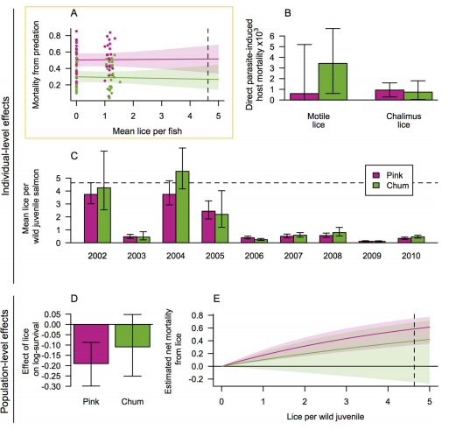
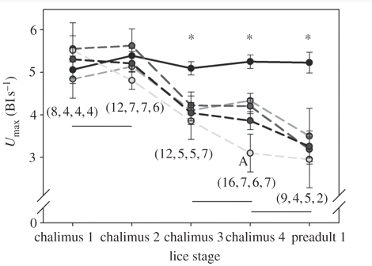
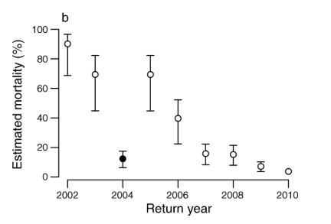
Introduction Study System Importance of Lice Parasitism Methods Initial Results Next Steps
(Brauner et al. 2012)
(Peacock et al. 2015)
(Peacock et al. 2013)
Notes:
We know that lice can have effects on juvenile salmon both from an individual level, with previous studies showing effects on swimming ability, the more lice present, the worse the individuals were at swimming to avoid predators. We also know there are population level changes going on, especially with pink and chum salmon. Pink salmon show population declines with increasing numbers of sea lice, based on return numbers to the Broughton archipelago. There are also more complex population level affects here, with pink and chum salmon. These two school together as juveniles, and they’re both predated on by coho salmon, but the coho’s prefer to prey on the pink salmon. They also prefer to prey on both pink and chum that are infested, and there have been non-statistically significant findings that show pink salmon are predated on more heavily when they’re infested. All in all, it’s clear that sea lice infestations have an effect. There is also work to show that in sockeye salmon, sea lice infestations reduce the competitive ability of the fish.

Slide 8
Introduction Study System Importance of Lice Parasitism Methods Initial Results Next Steps
?
?
?
?
?
?
L. salmonis
C. clemensi
Notes:
One thing we really don’t know yet is what’s happening with regards to the multi-host, multi-parasite system here, wherein we’re still unsure which parasites are most abundant on what salmon species and which salmon species are showing the highest levels of lice infestation, and what does this mean for the population dynamics of these salmon species?

Slide 9
Introduction Study System Importance of Lice Parasitism Methods Initial Results Next Steps
?
?
?
?
?
?
L. salmonis
C. clemensi
Notes:
One thing we really don’t know yet is what’s happening with regards to the multi-host, multi-parasite system here, wherein we’re still unsure which parasites are most abundant on what salmon species and which salmon species are showing the highest levels of lice infestation, and what does this mean for the population dynamics of these salmon species? Annecdotal evidence indicates that there is certain preference for certain hosts by the parasites, but that’s sort of uncelar. And a bit of a broader question might be why is it that all these species are migrating through the same environment but show differing infection regimes (potentially)?

Slide 10
Introduction Study System Importance of Lice Parasitism Methods Initial Results Next Steps
Does host abundance drive distribution of specialist parsites?
Hosts with low parasite richness are supposed to interact more with generalist parasites
Notes:
This raises a lot of potential questions surrounding this system as a host-parasite community, such as what are driving potential host-preference or host-specificity, how is parasite-coexistence being maintained, etc. If there are large populations of sockeye and pink, do you see higher levels of infection on these two? It’s been posited before that host abundance can affect the distribution of specialist parasites, so do we see more of the specialist salmonis parasite on the more abundant host species? Do we see high infection rates of one parasite coinciding with low infection rates of the other?

Slide 11
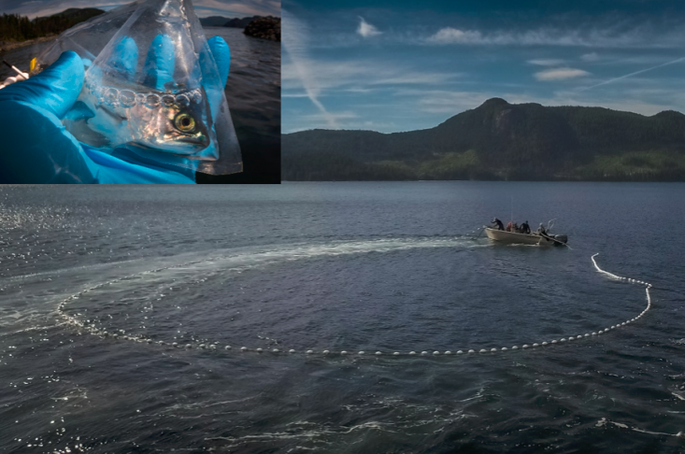
Introduction Study System Importance of Lice Parasitism Methods Initial Results Next Steps
(Godwin et al. 2015)
Notes:
So in order to get at all these questions, the Hakai juvenile salmon program has spent a significant amount of time since 2015, performing extensive sampling in the Discovery Islands and Johnstone Strait. This involves going out with these purse seine nets, catching a bunch of juvenile salmon, and then in conjunction with a bunch of other analysis, identifying their lice loads either there on the boat or later in the lab. They take data on the environmental conditions of the sampling location, measurements of the fish itself, they identify the number of lice, the species, and the stage of the different lice

Slide 12
Introduction Study System Importance of Lice Parasitism Methods Initial Results Next Steps
?
?
?
?
?
?
L. salmonis
C. clemensi
Notes:
And so now, I have this big dataset with parasite abundnaces on these three different species for 1000s of fish since 2015. And the main initial question is whether or not there’s a difference in the number of L. salmonis parasites vs. the number of C. clemensi parasites that infect these three fish species

Slide 13
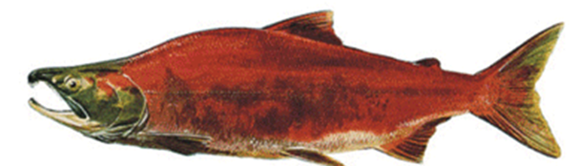
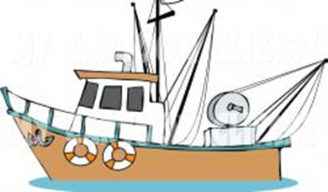
Introduction Study System Importance of Lice Parasitism Methods Initial Results Next Steps
Space and Time Collections

Slide 14
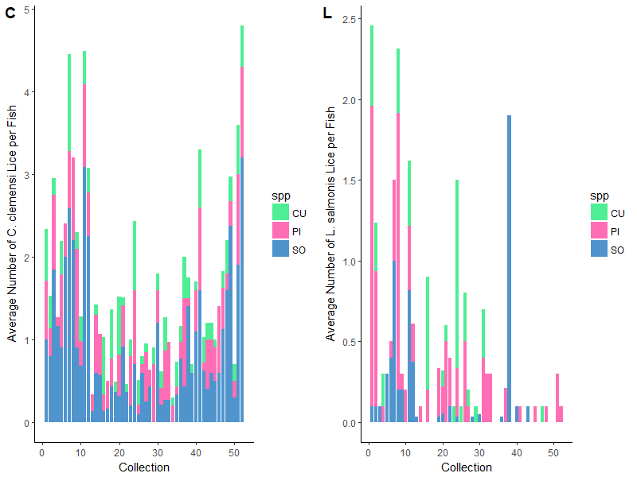
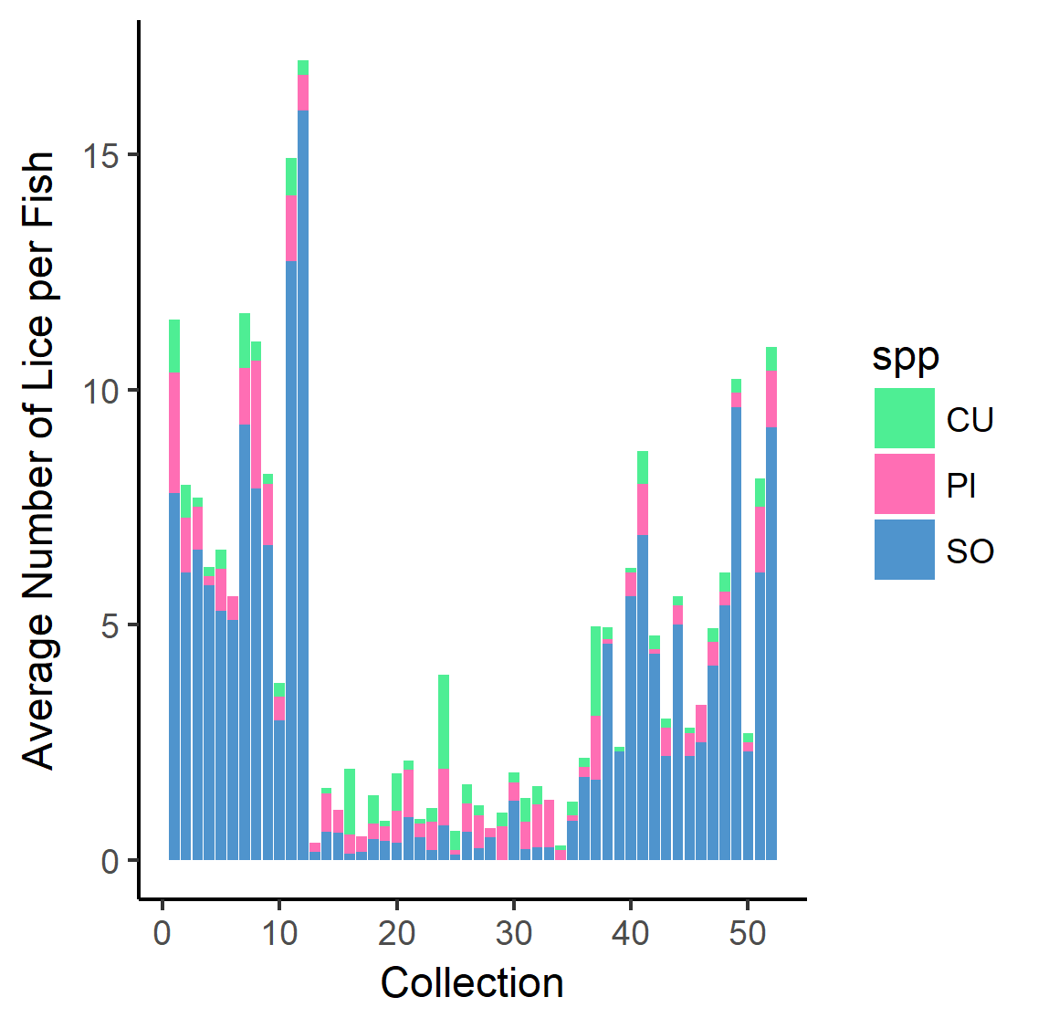
Introduction Study System Importance of Lice Parasitism Methods Initial Results Next Steps
First Pass at Analysis:
Used a GLMM with negative binomial distribution, where the salmon species is treated as a fixed effect and the collection as a random effect
Initially looks like there’s some species level differences

Slide 15
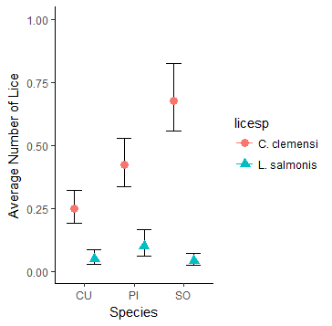
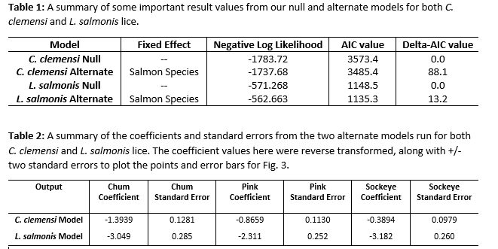
Introduction Study System Importance of Lice Parasitism Methods Initial Results Next Steps
Notes:
And so what we see so far, at least from these initial findings is that there is in fact a difference in infection between fish species. And what this is showing actually confirms what Marty and Sean Godwin have been thinking they’ve been seeing for some time now, and that’s that the sockeye salmon have significant numbers of C. clemensi, and the pinks are the ones with the most L. salmonis. And so this graph was made by reverse transforming the coefficients along with plus or minus two standard errors and plotting that as an estimate of the number of lice per fish, with a 95% confidence interval.

Slide 16
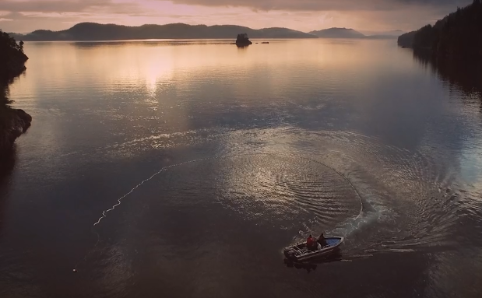
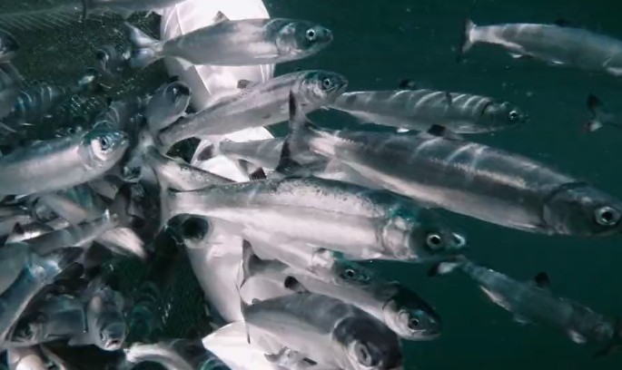
Introduction Study System Importance of Lice Parasitism Methods Initial Results Next Steps
Adding more covariates!
Start by adding in more environmental variables such as salinity, temperature, day-of-year etc. along with more information about the fish themselves (e.g. length, width etc.)
Also begin splitting up the lice by stages and see if that leads to anything interesting!
Notes:
And so what we see so far, at least from these initial findings is that there is in fact a difference in infection between fish species. And what this is showing actually confirms what Marty and Sean Godwin have been thinking they’ve been seeing for some time now, and that’s that the sockeye salmon have significant numbers of C. clemensi, and the pinks are the ones with the most L. salmonis. And so this graph was made by reverse transforming the coefficients along with plus or minus two standard errors and plotting that as an estimate of the number of lice per fish, with a 95% confidence interval.

